Slide 1


EiC Azure 101 Workshop

Slide 2
Azure. Cloud for all.
Productive
Hybrid
Intelligent
Trusted
Notes:
Azure. Cloud for all.
These 4 pillars represent the main value proposition for what differentiates Azure from the competition.
As you can see in the proof points, these are the reason why customers choose Microsoft, because of the unique value that we provide in a productive, hybrid, intelligent, and trusted cloud.
With Azure, you can do—or be—all of these things.
Productive
Get unparalleled developer productivity with integrated tools from mobile DevOps to serverless computing.
Learn about accelerating innovation
Hybrid
Develop and deploy where you want, with the only consistent hybrid cloud on the market. Extend Azure on-premises with Azure Stack.
Learn about our consistent hybrid cloud
Intelligent
Create intelligent apps that delight with data-driven experiences. Go quickly from concept to release with Azure data services and artificial intelligence, from image recognition to bot services.
Learn about intelligent apps
Trusted
Join startups, governments, and 90 percent of Fortune 500s that trust the Microsoft Cloud for security, privacy, transparency, and the most compliance coverage of any cloud provider.

Slide 3
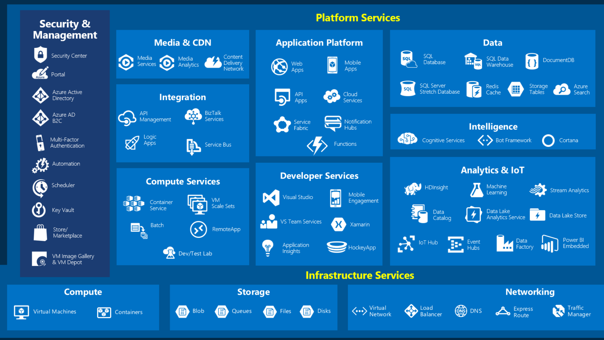
Notes:
Azure Marchitecture
This is a broad overview of the 140+ azure services we have available for customer use.
They are organized by Tools, Advanced workloads (PaaS), core infra (IaaS), and Azure Stack + hybrid.
This is not a complete listing of all the of the services, but highlights some of the key/main areas that customers need.

Slide 4
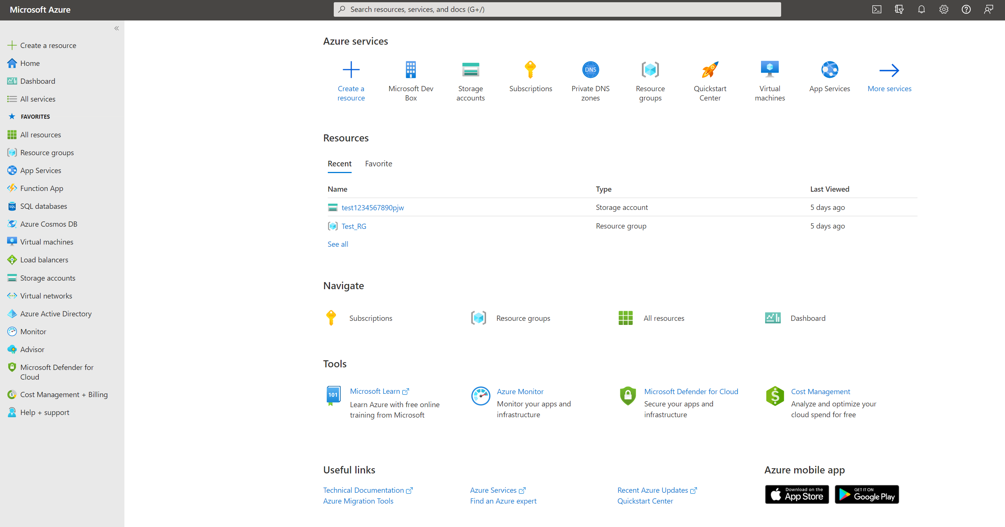
Azure Portal
The Azure Portal as the name suggests, is a single portal or a single junction that lets you access and manage all your applications at one place.
It lets you build, manage and monitor everything from simple web apps to complex cloud applications in a single, unified console.

Slide 5
Azure Portal
HANDS ON LAB
Azure Portal
https://portal.azure.com

Slide 6
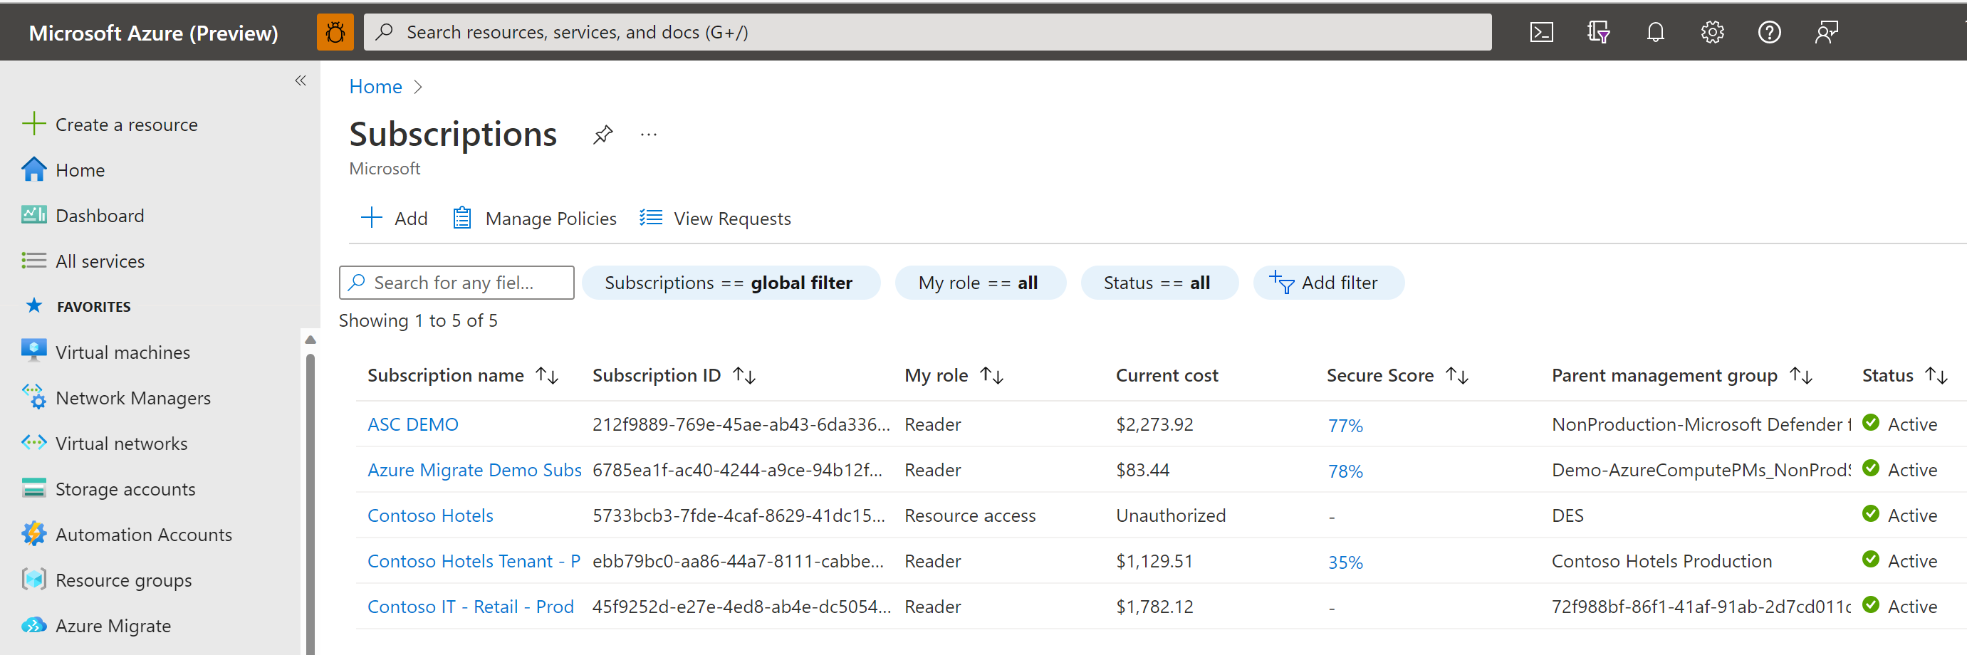
Azure Subscriptions
An Azure subscription provides you:
Authenticated and authorized access to Azure products and services.
A logical unit that links to an Azure account.
Azure offers free and paid subscription options to suit different needs and requirements.
You can use Azure subscriptions to define boundaries around Azure products, services, and resources. This includes:
Billing boundary which determines how an Azure account is billed for using Azure.
Access control boundary which applies access management policies at the subscription level.
An account can have one subscription or multiple subscriptions that have different billing models, and to which you apply different access-management policies.

Slide 7
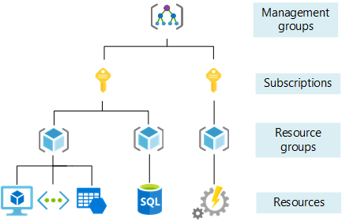
Azure Subscriptions
HANDS ON LAB
Azure Subscription

Slide 8
Resource Groups
A resource group is a unit of management, like a container that allows you to aggregate and manage all resources required for an application to run within a single manageable unit
Resource groups allow you to control costs, set automation and set policy against resources

Slide 9
Resource Groups
HANDS ON LAB
Create A Resource Group
Lab 1: Creating a Resource Group

Slide 10
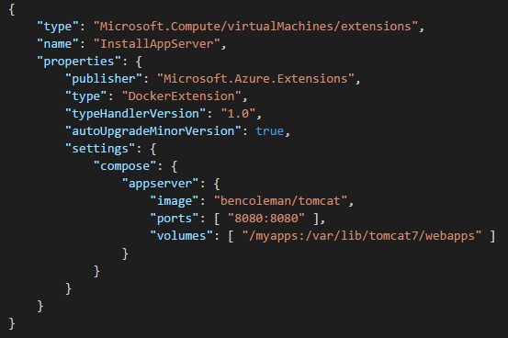
Resource Manager
ARM Template
{ "parameters": {}, "variables": {}, "resources": [ { type: "Microsoft.Compute/virtualMachines" } ], "outputs": {} }
Azure Resource Manager is a management layer in which resource groups and all the resources within it are created, configured, managed, and deleted.
With Azure Resource Manager, you can:
Deploy application resources
Organize resources
Control access and resources
Azure Resource Manager, provides a consistent management layer that allows you to automate deployment and configuration of resources using different automation and scripting tools, such as Azure PowerShell, Azure Command-Line Interface, Azure portal, REST API, and client software development kits (SDKs).
INFRASTRUCTURE AS CODE

Slide 11

Virtual Networking Services

Slide 12
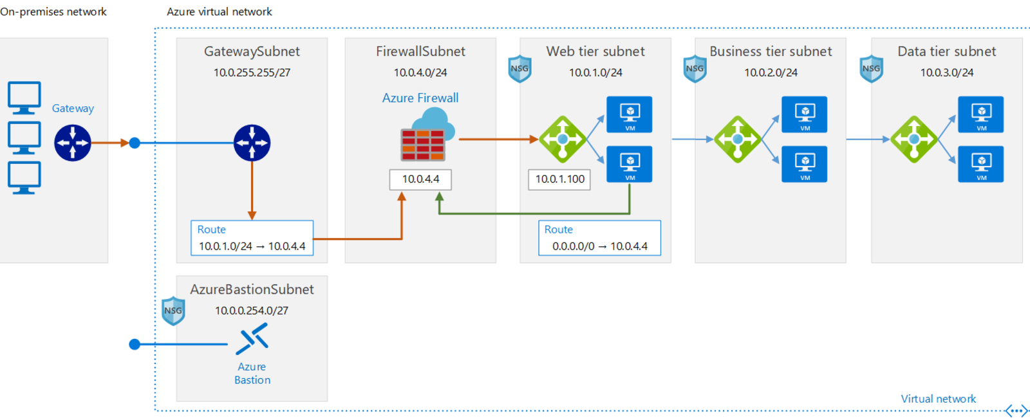
Virtual Network
An Azure Virtual Network (VNet) is the fundamental building block for your private network in Azure.
VNet enables many types of Azure resources, such as Azure Virtual Machines (VM), to securely communicate with each other, the internet, and on-premises networks.
VNet is similar to a traditional network that you'd operate in your own data centre but brings with it additional benefits of Azure's infrastructure such as scale, availability, and isolation.

Slide 13

Virtual Network
azure101vNet
Private network address space(s)
Dedicated to the subscription
Isolated
CIDR notation
10.4.0.0/20
Notes:
Classless inter-domain routing (CIDR)
Address space for 10.4.0.0/20 is 10.4.0.0 – 10.4.15.255
Private address spaces:
10.x.x.x/8
172.16-31.x.x/12
192.168.x.x/16

Slide 14
Subnets
azure101vNet
webSubnet
dbSubnet
Subnets within the vNet address space
Non-overlapping
Do not need to be contiguous
Automatic route table between subnets
Default route out to internet
10.4.1.0/24
10.4.2.0/24
10.4.0.0/20
Notes:
Private address spaces:
10.x.x.x/8
172.16-31.x.x/12
192.168.x.x/16

Slide 15

Network Security Groups
azure101vNet
webSubnet
dbSubnet
Layer 4 security rules
Inbound & outbound
Tuples – address, port, protocol
Subnets and NICs
Defaults
Within vNet
To the internet
Load balancer
RDP & SSH
10.4.1.0/24
10.4.2.0/24
10.4.0.0/20
Notes:
Load balancer rules for probes
RDP port is 3389/UDP

Slide 16

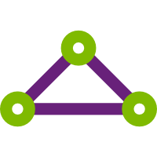
Gateway Subnet and Virtual Network Gateways
azure101vNet
GatewaySubnet
webSubnet
dbSubnet
Special case
Virtual Network Gateways
VPN Gateway
ExpressRoute
No NSG
S2S VPN
VPN Gateway
ExpressRoute
ExpressRoute
Gateway
10.4.0.0/27
10.4.1.0/24
10.4.2.0/24
10.4.0.0/20

Slide 17
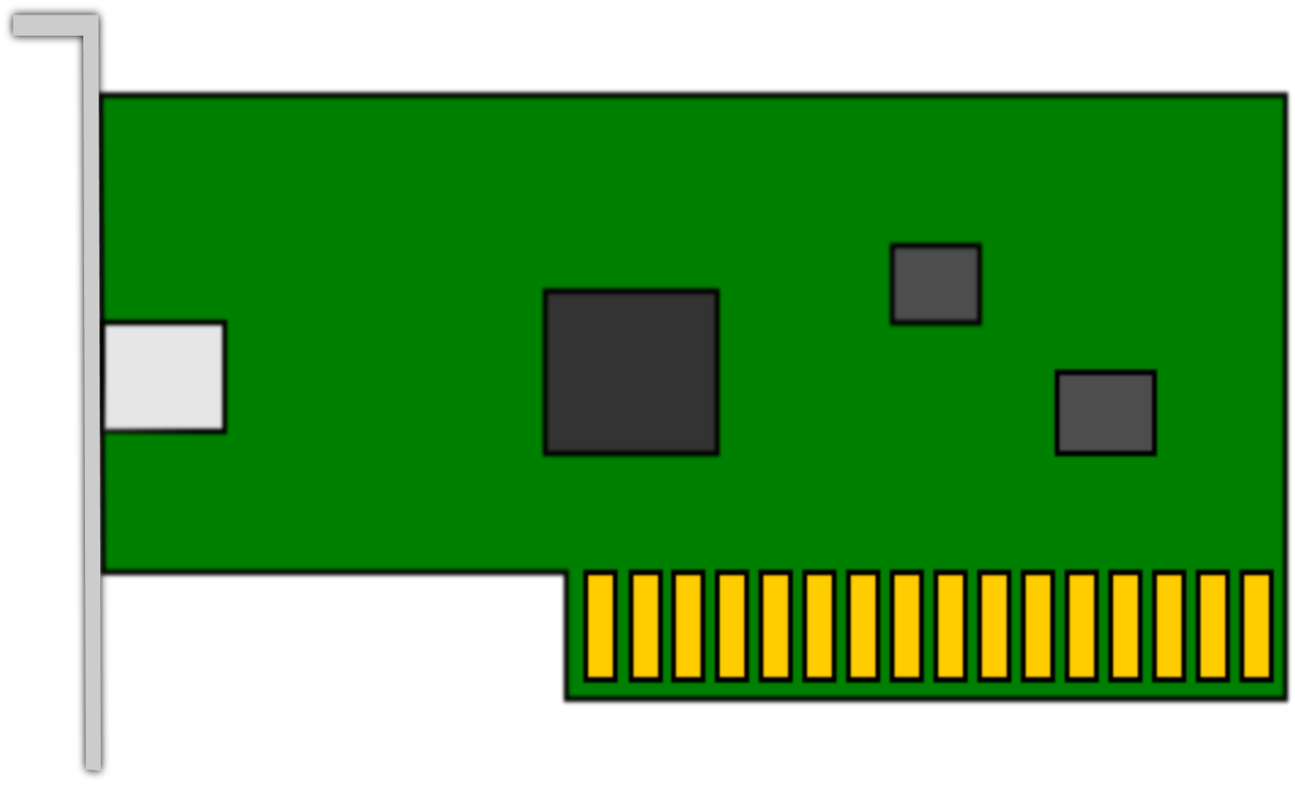

NICs and PIPs
azure101vNet
GatewaySubnet
webSubnet
dbSubnet
One NIC by default
IP allocated, may be reserved
Multiple NICs
Multiple IPs
S2S VPN
VPN Gateway
NIC
ExpressRoute
Public IP (PIP)
Azure DNS name
ExpressRoute
Gateway
10.4.0.0/27
10.4.1.0/24
10.4.2.0/24
10.4.0.0/20
PIP
Notes:
PIP from external address range for that region
May be reserved as well
Public DNS name to fixed format for all public services
Can use company public DNS with CNAME to redirect

Slide 18
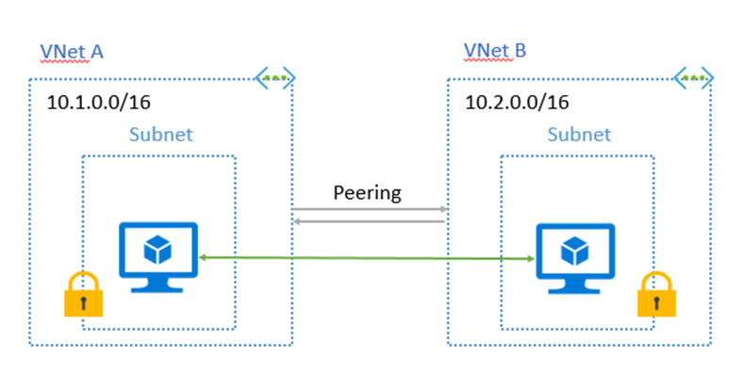
vNet Peering
Private: Peer Traffic is private and does not leave the Microsoft Backbone
VNets in different Azure regions can be peered to build a global VNet.
Easy to set up and manage: Set up with just a couple of clicks from the Azure portal or using PowerShell, CLI or REST API
Low latency: Cross region connectivity has no extra hops or internet, a low latency connection is created
No bandwidth restrictions: Bandwidth is determined based on bandwidth restrictions of the resources deployed in the VNet

Slide 19
Virtual Network
HANDS ON LAB
Create A Virtual Network
Lab 2: Creating a Virtual Network

Slide 20

Compute (VM’s)

Slide 21
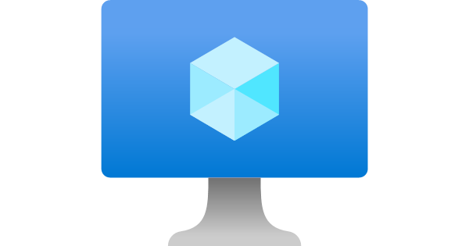
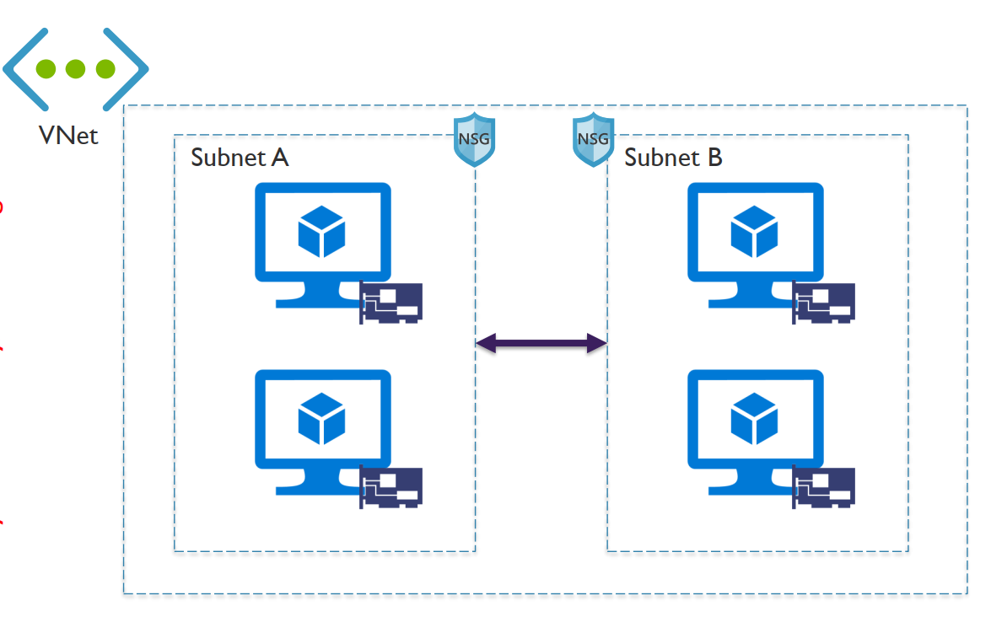
Virtual Machine
An Azure virtual machine is an on-demand, scalable computer resource that is available in Azure.
Virtual machines are generally used to host applications when the customer requires more control over the computing environment than what is offered by other compute resources.
When you leverage a virtual machine to host your application, you get the flexibility of virtualization without the need to buy or maintain any underlying physical hardware.
You will have to manage the typical tasks that are associated with any other server, including configuration, patch management, and software installation.

Slide 22
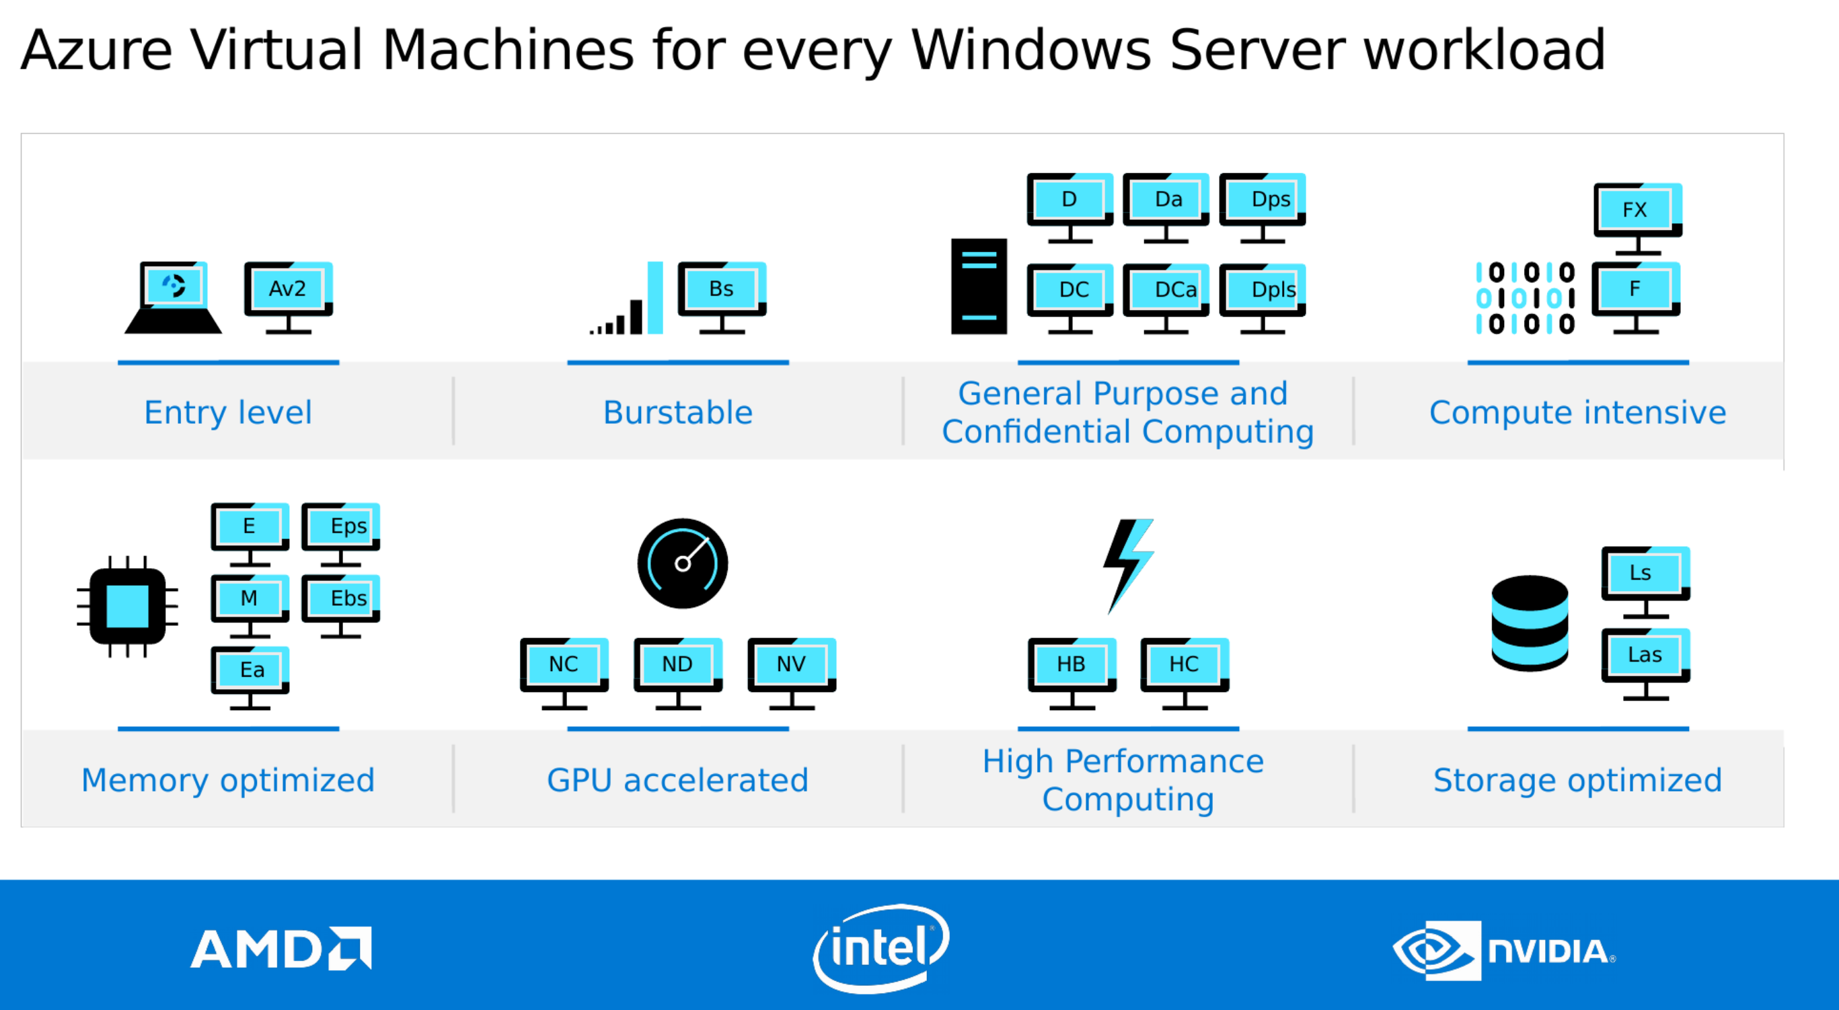
Virtual Machine

Slide 23
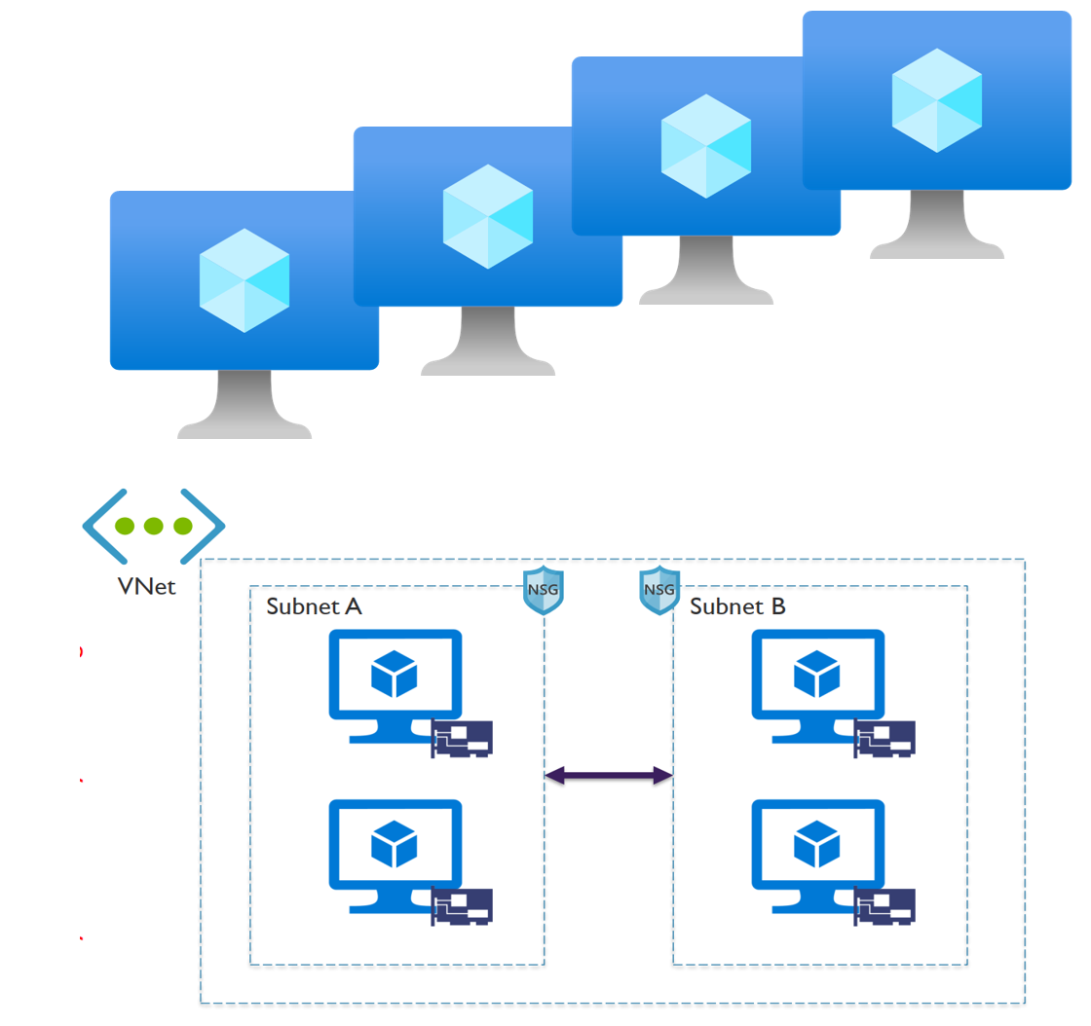
Hands On Lab
HANDS ON LAB
Create A Virtual Machine
Lab 3: Creating a SQL Server VM

Slide 24
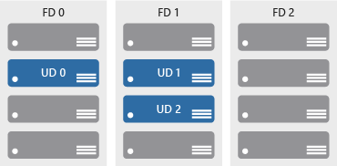
Availability Sets
Availability sets comprise of update and fault domains:
Update domains. When a maintenance event occurs (such as a performance update or critical security patch applied), the update is sequenced through update domains.
Fault domains. Fault domains provide for the physical separation of a workload across different hardware in the datacenter.
Availability sets help ensure applications remain online during maintenance events, or hardware failure.

Slide 25
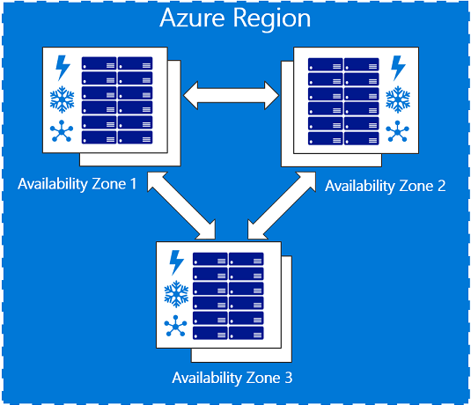
Availability Zones
Availability zones are physically separate locations within an Azure region.
Each availability zone is made up of one or more datacenters equipped with independent power, cooling, and networking.
Availability Zones are set up to be an isolation boundary.
If one availability zone goes down, the other continues working.

Slide 26
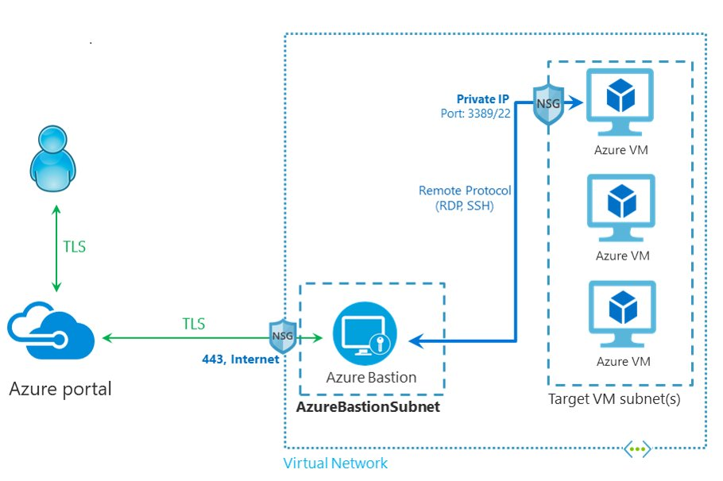
Azure Bastion
Azure Bastion provides customer with an Azure Portal Web Interface that provides secure access to your virtual machines.
Essentially, Azure Bastion is a jump server, so you don’t have to expose your VM’s to the internet.
Azure Bastion Host servers are designed and configured to withstand attacks.

Slide 27
Azure Bastion
HANDS ON LAB
Create Azure Bastion

Slide 28
Azure Storage Services
IaaS
PaaS
Virtual machines
Existing frameworks
Web and mobile
Microservices
Serverless Compute
Storage
Networking
Disks
Persistent disks for Azure IaaS VMs
Premium Storage Disks option: SSD based, high IOPS, low latency
Files
Fully Managed File Shares in the Cloud
SMB and REST access
“Lift and shift” legacy apps
Objects
Highly scalable, REST based cloud object store
Block Blobs: Sequential file I/O
Cool Tier Available
Page Blobs: Random-write pattern data
Append Blobs
Tables
Massive auto-scaling NoSQL store
Dynamic scaling based on load
Scale to PBs of table data
Fast key/value lookups
Queues
Reliable queues at scale for cloud services
Decouple and scale components
Message visibility timeout and update message to protect against unreliable dequeuers
Built on a unified Distributed Storage System
Durability, Encryption at Rest, Strongly Consistent Replication, Fault Tolerance, Auto Load-Balancing
Notes:
Cloud services and cloud usage are broadly defined as existing across infrastructure services or IaaS and higher layer platform services or PaaS. The Azure Storage services span both categories.
On the IaaS side we provide single instance storage for VMs in the form of our Disks service and SMB shared storage which we call Azure Files.
On the PaaS side we provide an unstructured object store called the Blob Storage service which offers Exabyte scale and the ability to store trillions of objects across different tiers within the cloud. Our current cloud object storage tiers are hot storage for higher performance and frequently accessed data and cool storage for active archives. In addition to unstructured data, we also have the NoSQL Tables service for semi-structured and structured data and the Queues service for reliable intra and inter-service communication.

Slide 29
Azure Storage Durability
Typically >300mi
Typically >300mi
Async
Async
Primary
Secondary
Primary
Secondary
LRS
3 replicas, 1 region
Protect against disk, node, rack failures
Write is ack’d when all replicas are committed
Superior to dual-parity RAID
GRS
6 replicas, 2 regions (3/region)
Protects against major regional disasters
Asynchronous to secondary
RA-GRS
GRS + Read access to secondary
Separate secondary endpoint
RPO delay to secondary can be queried
Strong consistency, checksums/CRC and background scrubbing to preserve data integrity

Slide 30
Azure Disks
Best value persistent storage for your business-critical workloads
Secure by Default
Highly Available
Simple
Big Scale
Encryption at Rest
Granular RBAC, Policy and Tagging
Prevents single points of failure due to storage
Ease of maintenance using Managed Disks
50K disks + 50k snapshots per subscription per region
Industry leading ZERO % Annual Failure Rate
Best in class high I/O performance VMs
Single instance SLA of 99.9%
Easy migration from other platforms
Enterprise grade durability with 3 replicas
160,000 IOPS & 2 GiBps
Disk throughput per VM
Using Premium SSDs and Ultra Disks
Rich partner ecosystem
enabled by REST APIs

Slide 31
Azure Disk Portfolio
Standard HDD
Standard SSD
Premium SSD
Ultra Disk
Single disk max value
Low-cost storage
Consistent performance
High performance
Sub-millisecond latency
Size
32 TiB
32 TiB
32 TiB
64 TiB
IOPS
2,000
6,000
20,000
160,000
Bandwidth
500 MBps
750 MBps
900 MBps
2,000 MBps
Latency
> 1 ms
1 ms
1 ms
< 1ms
Workloads
Backups, low end file server
Big Data, entry-level Web Servers
Databases, enterprise production, container volumes
SAP HANA, SAN, Tier-1 workloads
http://aka.ms/azuredisks
Notes:
Q1: Can you share some of the benefits of the new disk sizes and why its relevant to customers?
A: With the new disks size, the max single disk capacity is increased to 32TB along with performance target at 20,000 IOPS and 900 MBps on Premium Disks. It provide customers much better flexibility to scale their persistent disk storage independent of VM. Even the smallest VM can get up to 64TB disk space. Besides, this also simplify management experience by avoiding the need to stripe multiple disks to achieve larger capacity or high performance.
99.999% availability and have consistently delivered enterprise-grade durability with an industry-leading zero-percent annualized failure rate.
Standard SSD: Now GA. Low-cost storage with consistent latency for low-IOPS workloads.
Improve reliability and scalability for your applications.
Deliver lower latency compared to Standard HDDs. web servers, low-IOPS application servers, lightly used enterprise applications, and dev/test scenarios.
Premium SSD: High-performance disk storage for production workloads
ANNOUNCING
Ultra SSD: Larger size per disk. More IOPS per disk. More Bandwidth. All at amazingly fast latency.
Experience maximum disk throughput per virtual machine of up to 80,000 IOPS and 2,000 MB per second—and even faster with caching.
INVITE Aung Oo on stage to demo Ultra SSD.

Slide 32
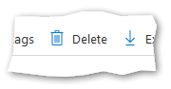
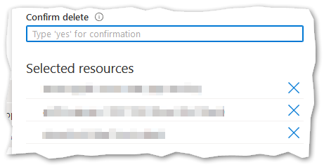

You’ve Finished !!!!
Make sure you have completed the final lab before you leave!

